Slide 1

Notes:
Hello Everyone.. and Welcome….
Thank you for your precious time.
The day we have been preparing for over a month has finally arrived. We faced so many challenges, acquired new skills, learned new technologies, and built this application from scratch.
The application that we have built is SwiftQ Solution which is providing a solution such that we no longer need to wait in a queue in any customer service center.
Now let's go further to the upcoming slides where will give detailed information about the Microservices and UI that our team has built.
Before that Let me introduce to our Tech developers who have worked on this SwiftQ Solution project.

Slide 2
Team Members
Nanita
Tarannum Afshan
Abinash Nahak
Pathlavath Suresh
Pravin Devkar
Notes:
Before that Let me introduce to our Tech developers who have worked on this SwiftQ Solution project.
First one is me AchalKumar Ajmera then we have Alok Singh Kushwah and Bandi Bhadraiah we are the Backend Team who have built all the microservices.
Then we have Abinash Nahak, Nanita, Pathlavath Suresh,Pravin Devkar and Tarannum Afshan they are the Front-End team who have built an elegant UI components..
And Our Mentor Chaitali Chatterjee.

Slide 3
Pain Points
User may not be sure of the nearest service center location.
We have to wait in a queue which consume lots of time.
Service Center may have less space to attend many customers at once.
Users are unaware of which service center to visit,as they are unaware of the quality of service they provide.
Users are unaware of all the services that Service Center offers.
Users are not able to get the notification for visiting the service center and even of transactions.
If some days lot of customers visit the service center that may result in sudden increase in workload of front desk and service staff and it will lead to manual errors and appointment mixups.
Notes:
As you can see this are the some of Pain points that we found out during brainstorming of the abstract problem/scenario.
Some of this points are Like user may not be sure which is the nearest service center that they can visit also we have observed that user has to wait in a queue which consumes lot of time.
Their could be a possibility that Users are not aware which service center to visit in terms of the quality of service and also their is also a possibility that user are unaware of the services that a particular service center is providing.
Apart from it During our brainstorming session we have also observed that user are not able to get all the notifications from the service center and even of all the transaction that they have made.
The last thing is that suppose If some days lot of customers visit the service center at a time then it may result in sudden increase in workload of service center that may lead to manual errors and appointment mixups.

Slide 4
Solutions
We are providing location for each service center, also user can filter service center based on state and city.
User can book the desired date and time from our application hence, queue time decreased to null.
Only desired number of users can come to service center based on slot booked, hence no chance for overcrowding.
We are providing features like review and rating for service center hence user can pick best service center based on this feature.
Service can fill the service that they are offering and it is visible to user.
We are providing a notification feature in our so user can get notification will they are booking any slot or creating any ticket or if they close booking or ticket.
User can only visit service center based on their booked slot hence the workload on the service side can be maintained as per the service center.
Notes:
Here is the solution that is SwiftQ Solution to overcome all difficulties which we discussed in our previous slide..
Like to overcome the issue of finding nearest location We are providing location for each service center which further can be filtered based on state and city.
Similarly we are giving option to user to book the slot based on their desired date and time which may decreased the queue time for the user also it will remove the problem for overcrowding.
We are also providing features like review and rating for service center hence user can pick best service center based on reviews and ratings also we are providing feature where service center can add all the services that they are offering so that users can be aware of all the services.
We are also providing a notification feature so that user can get notification when they are booking any slot or creating any ticket or if they close those.
And last as we know that users are only visiting as per their booked slot hence the workload on the service side can be maintained and their will be minimum too no manual errors and appointment mixups.

Slide 5
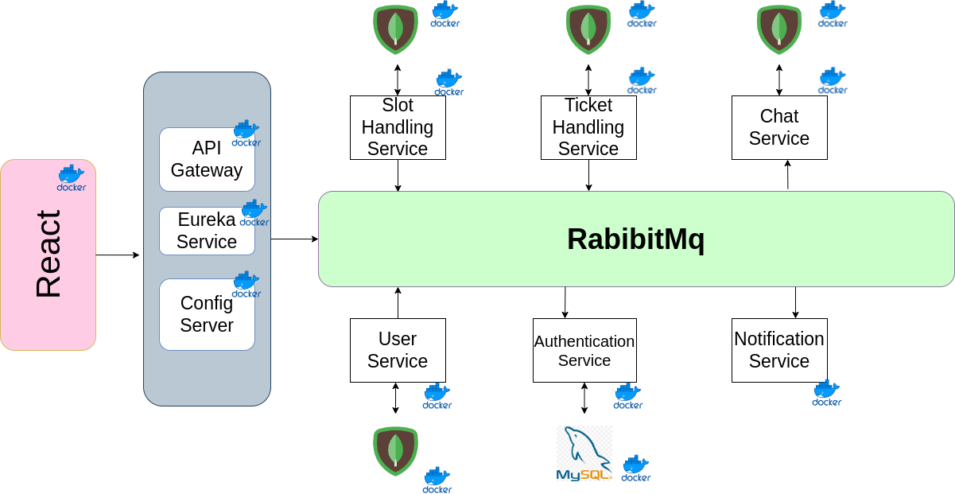
Architecture
Notes:
This is our project architecture where we have used ReactJS for the application's user interface.
Then we have used 3 microservices pattern in our application that is api gateway, eureka service and config server to interact with all microservices of the application.
We have also used RabbitMq for communication between all the microservices and docker for creating the container image of our application.
We have 6 different microservices in our architecture which are having separate databases.
Now Alok will explain this microservices in detail.

Slide 6
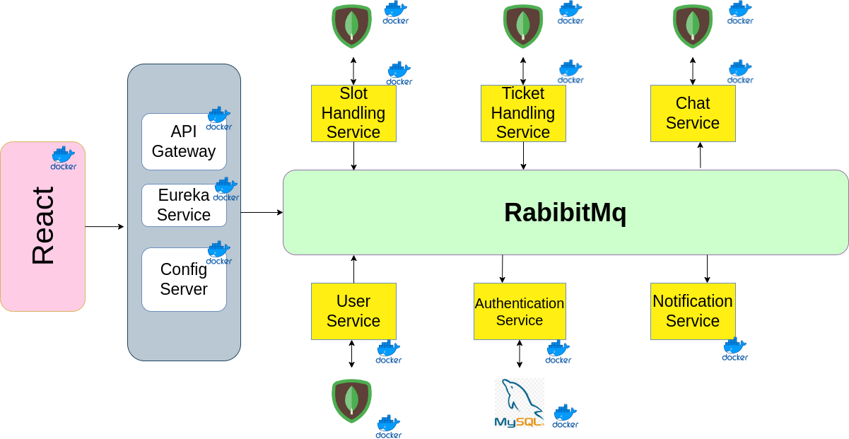
Microservices
Notes:
Thank You achal and Good Afternoon all, alok singh kushwah this side,
As achal said we have 6 microservices in our application now i am going to give u detail explanation about each one
First is User Service, for registering the User and ServiceCenter, that stores the details like email, pass, name, contact, role and address in mondodb database.
Then we have Authentication service To authenticate the user and servicecenter, while log in to our application.
Then we have Slot handling service where user can book the slot in any service center and service center can create a slots. this data also store in mongodb
Then we have Ticket handling service where user can create a ticket for online enquiry and problem.
Also we have chat service, Once the ticket is created, user and service center can do chat over the issue.
Last we have NOtification service, that we built to send email notification to user as well as servicecenter when any slot is booked or ticket is created or closed.
Now Abinash wil give you a quick demo for user side.
Over to you abinash.

Slide 7
Quick Demo
Notes:
Abinash : explain home page and click on login button and will login with existing user and then he’ll show the user side part of the application
Pravin : give a quick demo for the service center side

Slide 8
Database selection
Notes:
Thank you pravin
In our project,
We have used two Databases MongoDB and MySQL
Moving to next slide

Slide 9
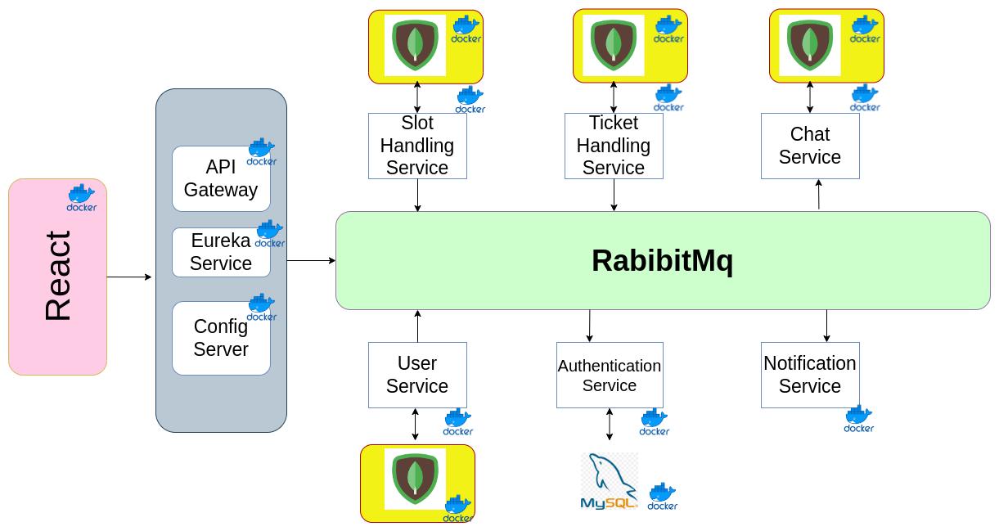
Mongodb
Notes:
The first database which we are using is mongodb
MongoDB's focus on availability means it has the ability to perform both reads and writes no matter how many users request it.
also, In MongoDB, all individual records are stored as documents, which are collections of fields with a dynamic schema. Here, each collection doesn’t require same set of fields, which makes it more flexible than RDBMS and that's the reason we have used this database in 4 of our microservices that you can see this image.
Moving to Next slide

Slide 10
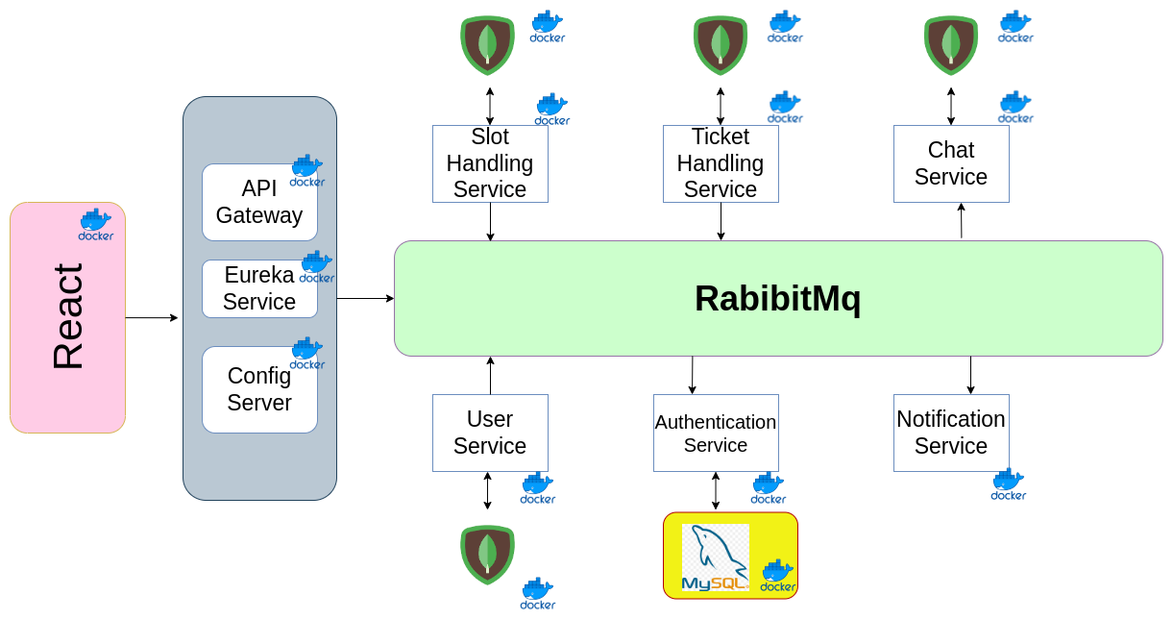
MySql
Notes:
And second one is mysql database which is used in authentication service to store email ids and passwords for users and service-center users because
Mysql is focused on consistency, Data Security, where every action is important.
MySQL is a Relational Database Management System which means that it stores data in tabular form. it consists of a solid data security layer to protect sensitive data like email and passwords.
Now, move to Next slide.

Slide 11
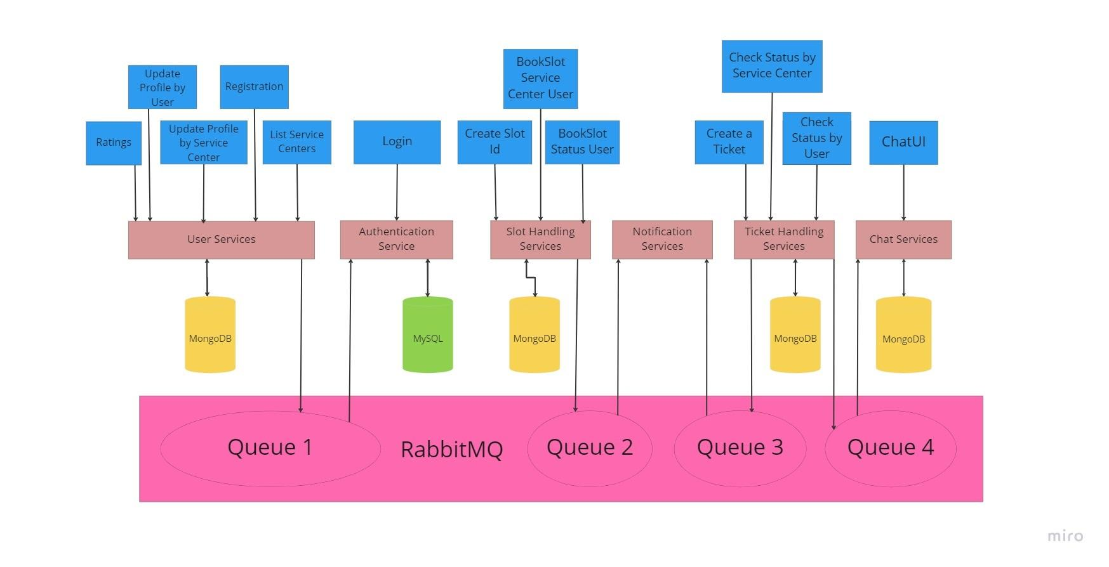
Data Flow Diagram
Notes:
This slide provides an overview of the Data Flow.
When a User or Servicecenter registers from Registration UI the data will received by Registration service and stores in the MongoDb database and then it publish the message to Rabbitmq and the Published message is consumed by the Authentication service for login and this detail stored in the MYSQL database.
then we have slot handling service, where service center can create a slot after that user can book that slot. This details stored in mongodb database and then it publish the msg to rabbitmq so i hope you get an brief idea how data flow works.
(so that notification service consume the detail like booking id, user desc, etc while sending a email notification.)
Thank you, thats it from my side,
(Now pravin will give you a detail demo.
Over to you pravin)

Slide 12
Detailed Demo 1
Notes:
Pravin : registration , update profile and update password for sc create slots and
Nanita : go to user side and explain registration , update profile and update password for user and go to book a slot and details and email notifications.
Suresh : create tickets and handover to tarannum
Tarannum : explain all the ticket status and chat service
Abinash : close the booking by adding price.

Slide 13
Detailed Demo 2
Notes:
Pravin : register new user and update profile and update password
Nanita : create a booking and show all bookings and download pdf
Suresh : create ticket Tarannum : from ticket status, will explain chat service from both sides and will close the ticket from service side
Abinash : will complete the booking by adding price

Slide 14
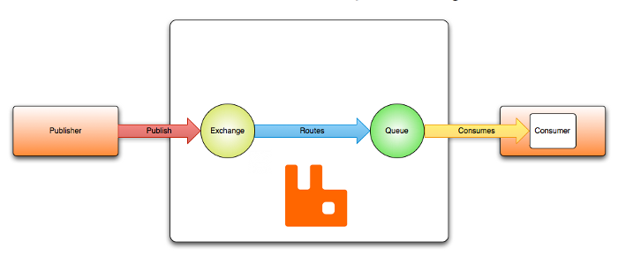
RabbitMQ
Port:15672

Slide 15
Microservices Pattern
Eureka Server
Api-Gateway
Config-server
Notes:
There are 3 microservices pattern in our application:
Eureka server, api gateway and config server.

Slide 16
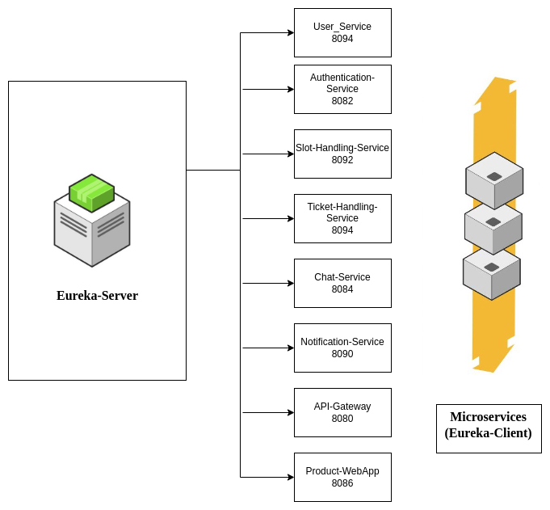
Eureka Server
Port: 8761
Notes:
Eureka Server is an application that holds the information about all client-service applications.
Every Microservice will register into the Eureka server and Eureka server knows all the client applications running on each port and IP address.
It is used for monitoring by developers, For better understanding in large applications. So to monitor all services, we use eureka server.

Slide 17
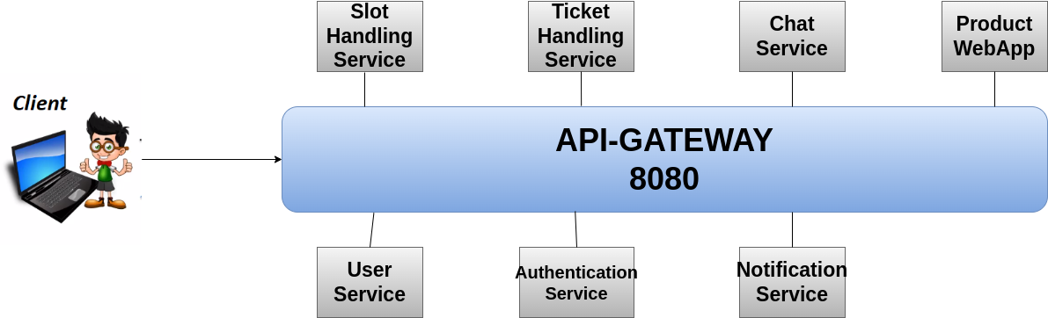
Api-gateway
Notes:
An API gateway is a software application between a client and a set of backend microservices.
The API Gateway serves as a reverse proxy to accept API calls from the client application, forwarding this traffic to the appropriate service.
It is used to route all services and keep all port numbers.
The API gateway also enforces security and ensures scalability and high availability.

Slide 18
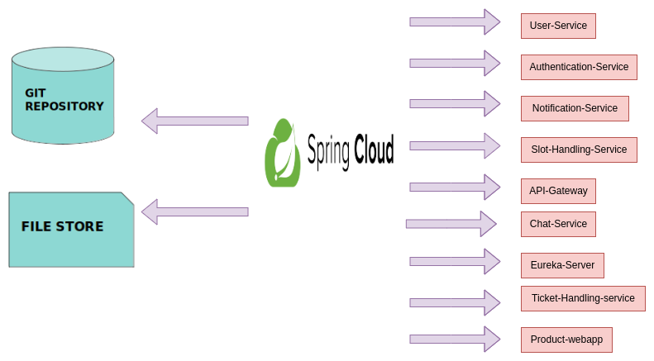
Config Server

Slide 19
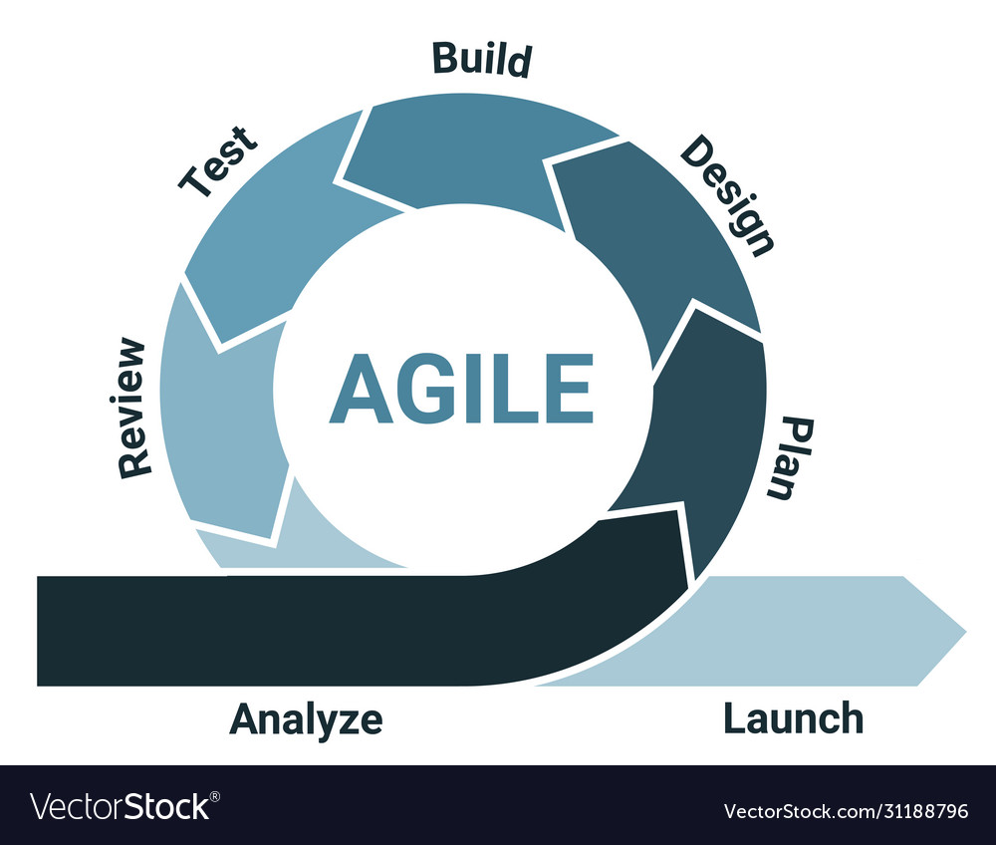
Agile Methodology

Slide 20
Revenue
We can provide this application to service center based on subscription basis.
We can show advertisement on our application.
User can subscribe for the premium service like fast handling of tickets.
We can generate revenue from promotion of subscribed service center.
Notes:
In order to sustain a project, financial support plays vital role. So here we figured out the scopes of earning from this platform.

Slide 21
Product Backlog & Revenue
Notes:
Now we are going to have a look on next version product enhancement which is left over for this product.
& how we can generate revenue from it.

Slide 22
Product Backlog
We will provide option for user to postpone or delete any booked slot.
We will provide real time direction for the service centers.
We will provide real time progress of any service.
We will provide notifications on whatsapp
We will provide third party login feature.
Notes:
For the next product release we are planning to add few more features which will benefit us in terms of value and revenue.

Slide 23




TechStack
Front-End:-
Back-End:-
Database:-
Other:-
Notes:
We have used technologies in frontend are HTML, CSS JavaScript, ReactJS.
For Backend we have used Java and Spring Boot.
Databases- We have used MYSQL and MongoDB RabbitMQ- We are using RabbitMQ as a message broker and DOCKER- to create containers and images for all the microservices and databases.

Slide 24

Notes:
This is all about our product….I hope you guys enjoyed our product glimpse..
It was a pleasure to show our product to GL and StackRoute mentors..
Sincerely thanking to Global Logic for giving us the ascend opportunity to upgrade our skills and also thanks to Chaitali Chatterjee our mentor who resolved all our queries and bugs on time, and Thanks to all stackroute mentors for giving us a wonderful training.
Thank you so much for your time and Have a Great Day!!
Now If you have any questions please feel free to ask..

